Slide 1
Classroom Lab Chapter 5
ITEC 1150 Programming Logic and Design

Slide 2
Hi, I'm Clara
I'm an instructor at MCTC too, mostly 2nd-year programming classes
I've been working on a project to help students work on their assignments

Slide 3
Problem
How do you know that your code is working correctly?
And, if you change it, or add features, does it still work?
Sure, you run and test it - but there's lots of possible valid and inputs and expected outputs
And when you develop and change code, it's a lot of work to keep testing it (with a range of valid and invalid inputs) to make sure everything is still working

Slide 4
Solution
Running code with different inputs every time it's changed is repetitive and boring
Repetitive, boring tasks are perfect tasks for a program!
So, we are working on bundling automatic tests with assignments
tests = code that runs your code, and checks if your code is working correctly

Slide 5
Solution
Covering how to write automatic tests is outside of the scope of this class
But please ask me after class if you are interested in learning more!
And you'll cover testing in 2nd year programming classes
So, we can give you a PyCharm project with the tests in
You'll write code as usual
And then you can run the tests as you work, to make sure your code is running correctly - in the way the assignment or lab expects it to

Slide 6
Sharing code - GitHub
Could give you a zip file of code, or put code in D2L...
But that's not what professional code developers do. It's not organized enough for bigger projects
We'll use the GitHub website to share the initial code (and tests) with you
PyCharm can download code from GitHub
When you've written your code, PyCharm can upload your work to GitHub
No zip files, no word documents :)
A little tricky to start with but really easy once you've got the hang of it

Slide 7
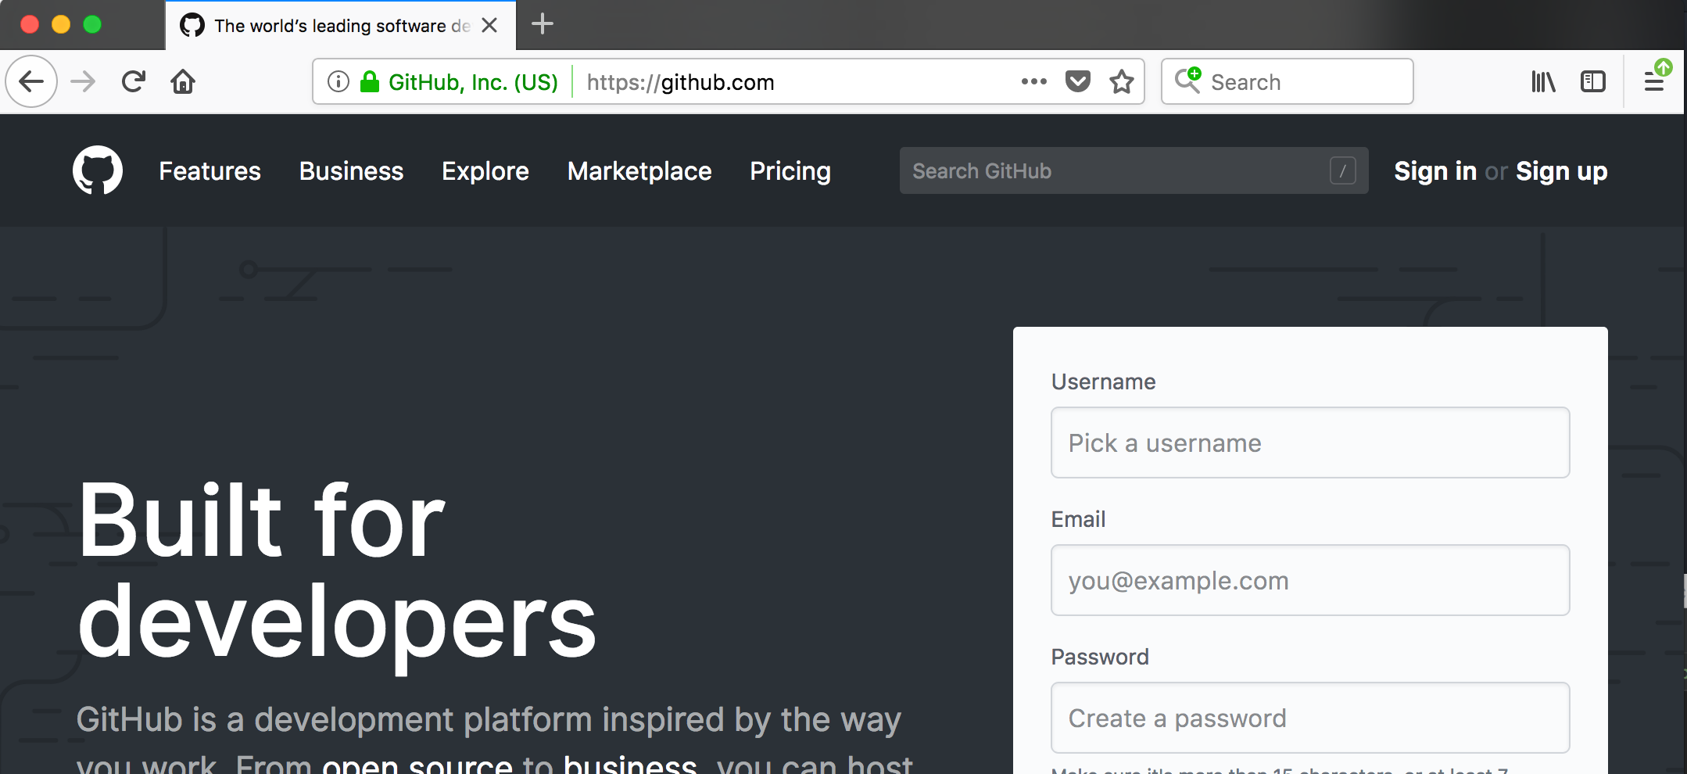
Sign up for a GitHub account
Go to www.github.com
Click Sign up

Slide 8
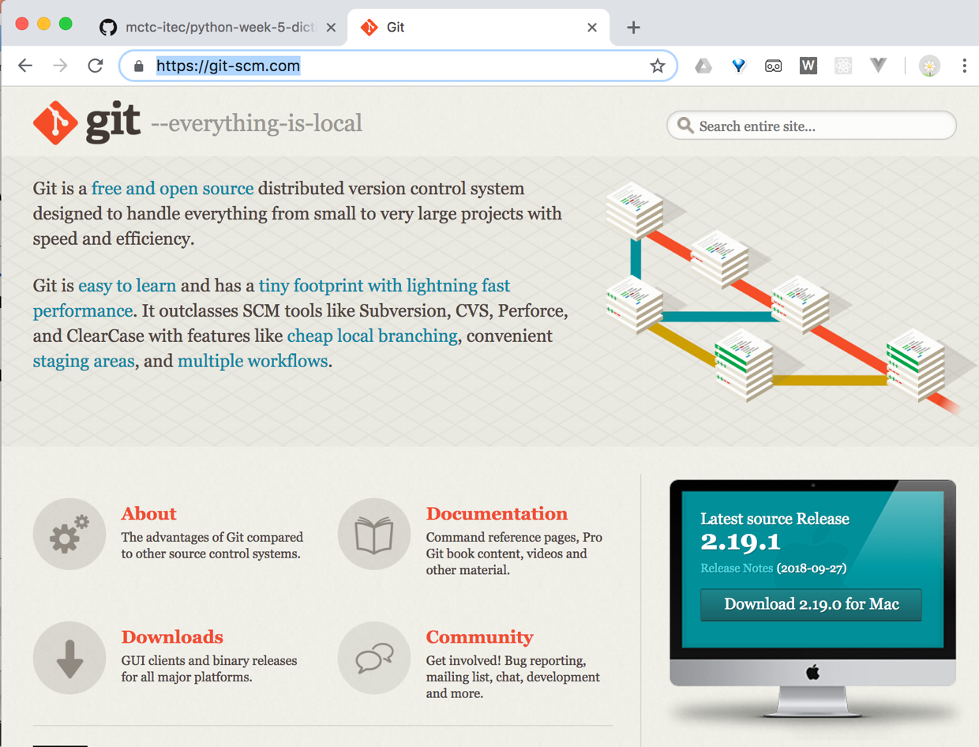
Working on your own Windows PC?
Install the git application from
https://git-scm.com/
Use all the defaults for the installation
Shout at me when the install is done, you need to configure PyCharm to find git, I'll walk you through it
Mac and Linux users: you already have git, skip this step
Lab PCs: you already have git, skip this step
Download button

Slide 9
GitHub
A code hosting website
Hosts open-source code for millions of programs
You can save your own code there too - useful for
backups
sharing your code - with the instructor, other students
making a portfolio of your work - great for showing off your skills job-hunting

Slide 10
And, instructors can share code with you
Today, we'll share an outline for your classroom lab assignment
It includes the start of the program you'll finish in lab
And, some tests to check if your program is working correctly

Slide 11
Get the code
Make sure you have activated your GitHub account
And are signed into GitHub
Now, go to this link: https://classroom.github.com/a/jdIuJE9T

Slide 12
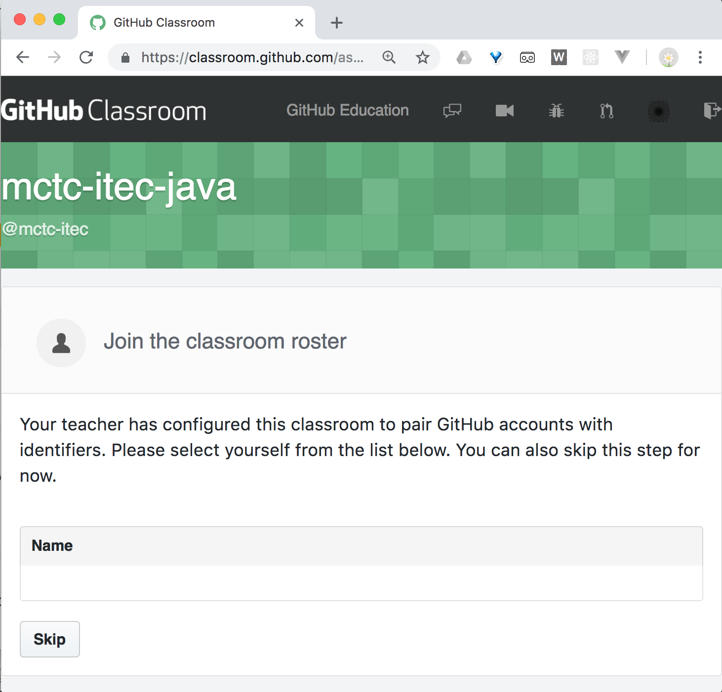
Add to roster - skip this step
Click the Skip button

Slide 13
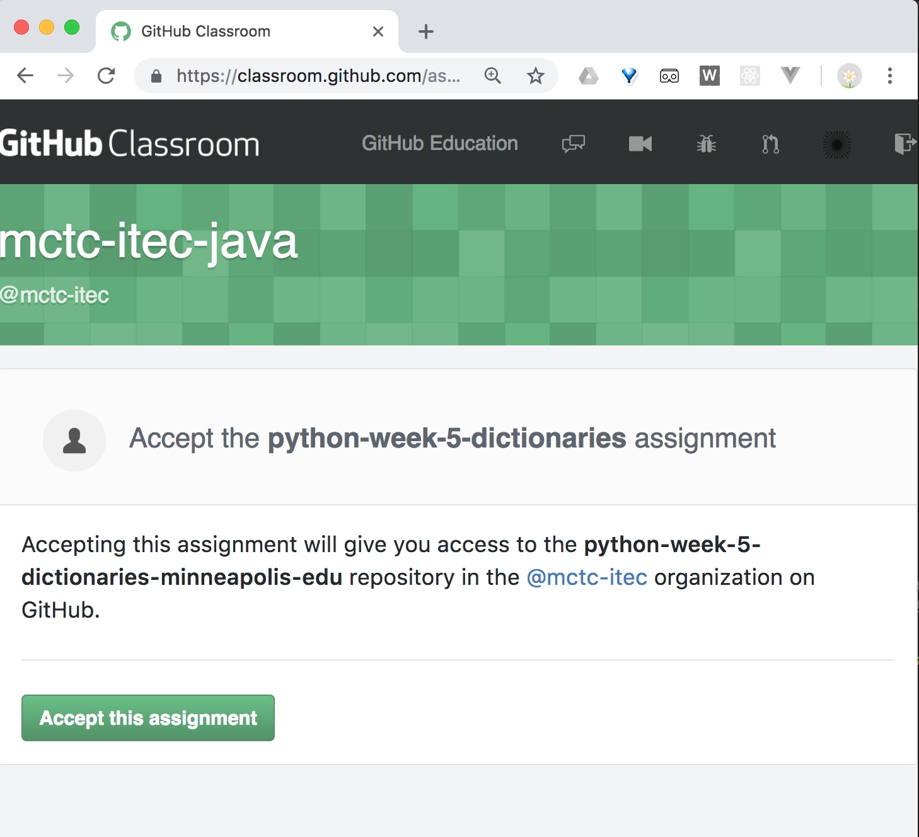
Accept the assignment
The name of the repository will have your GitHub username in it
Click the Accept this assignment button

Slide 14
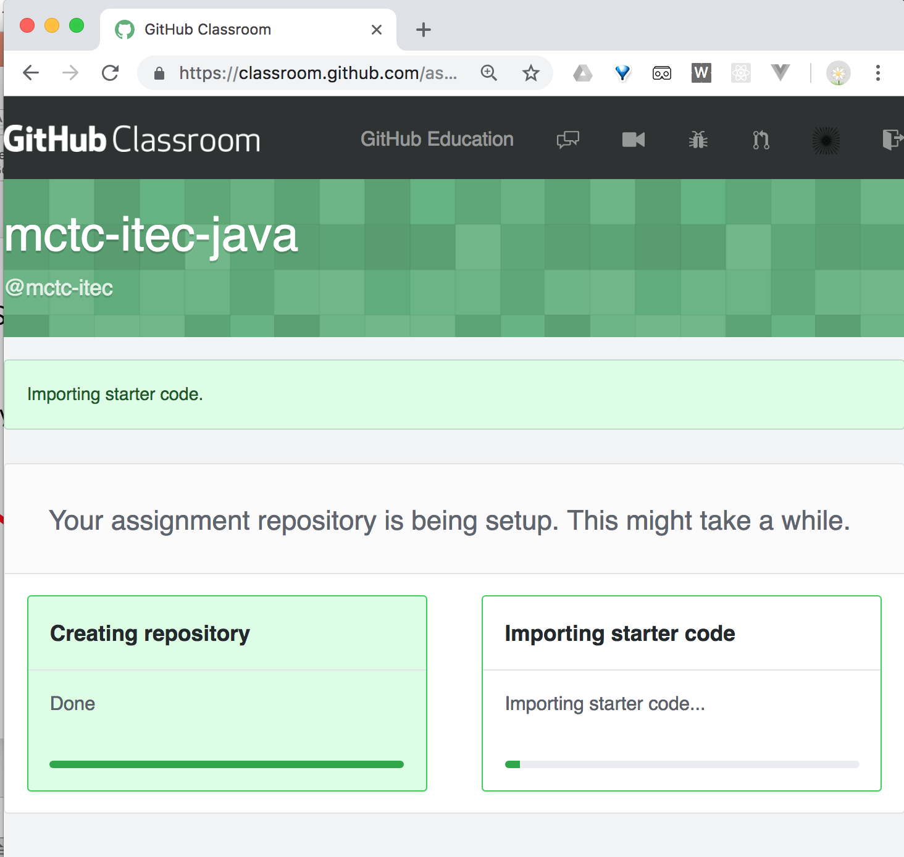
Wait...
GitHub will create a repository for you
This will have a copy of a starter PyCharm project
For this lab, you'll finish the code given

Slide 15
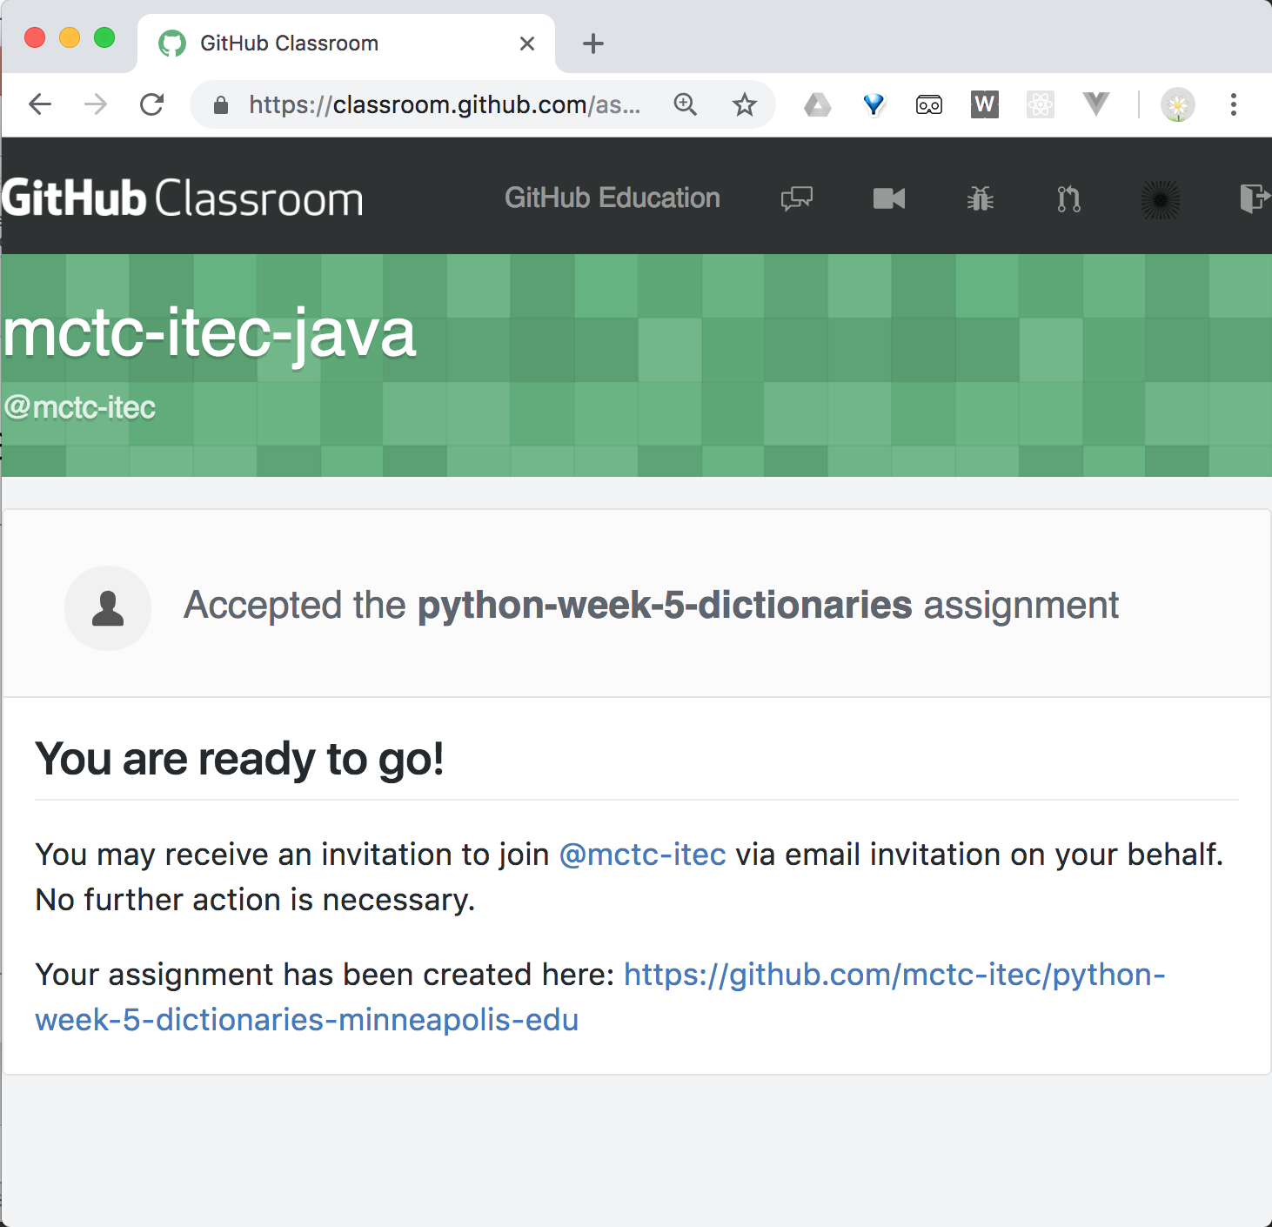
Repository Created
Make a copy of the 'Your assignment has been created here' link - this is the link for your repository
Yours will be different to the screenshot - it will have your own GitHub name in
Click on the repository link

Slide 16
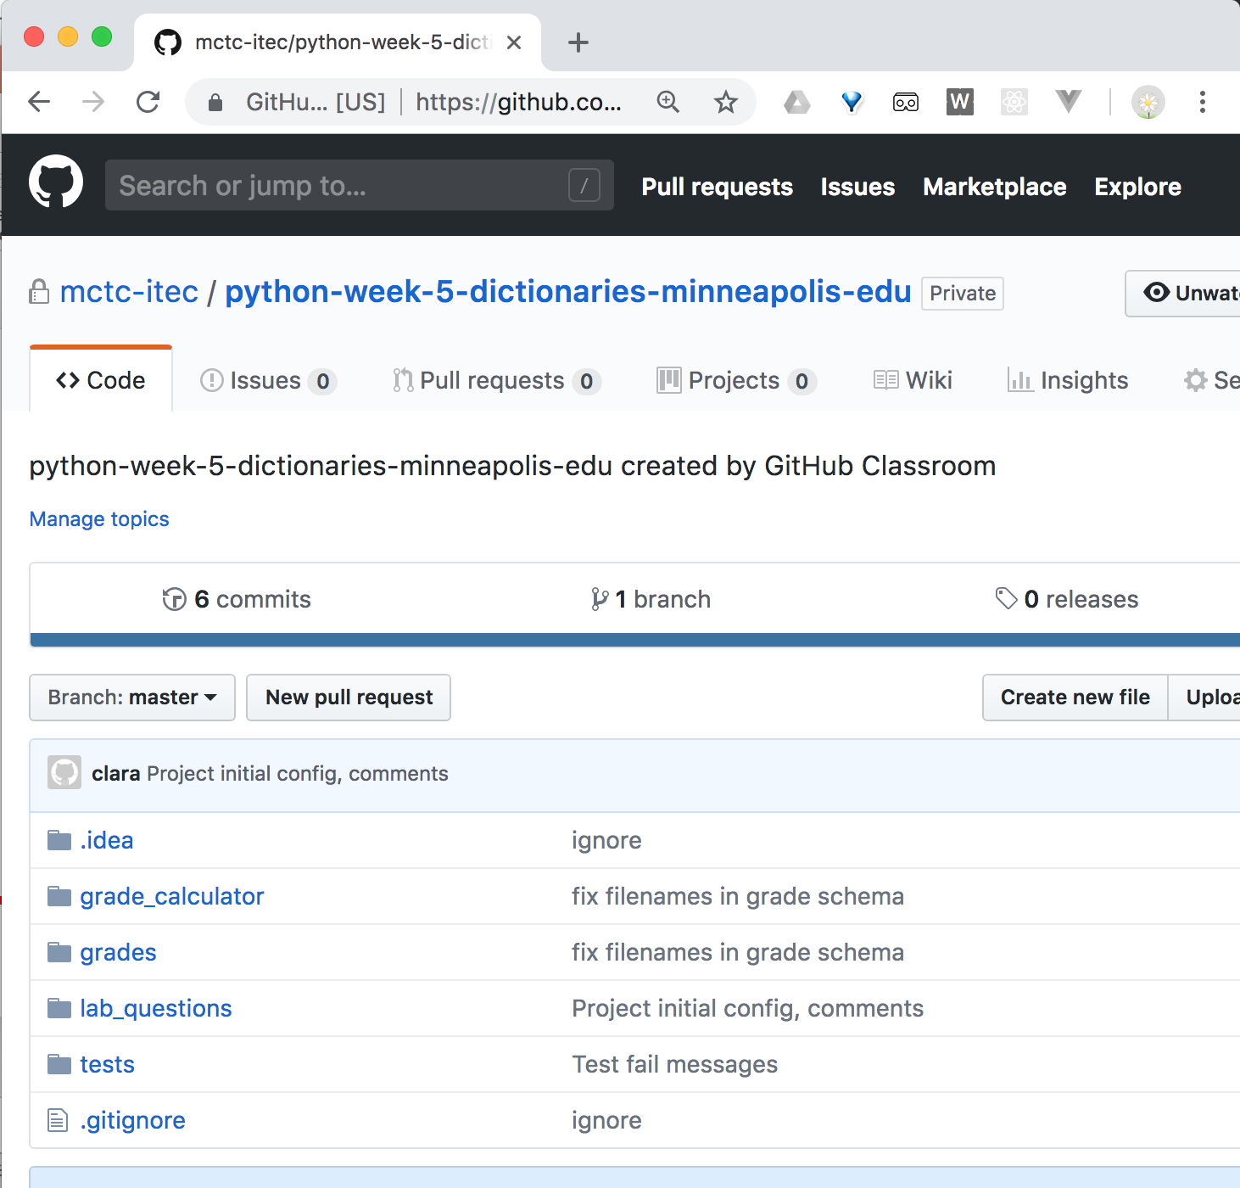
Your repository
Here's your repository
This is your copy of the code
Keep this page open - you'll need the URL several times, you'll come back and check this page during the lab

Slide 17
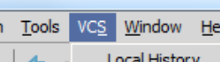
Getting the code onto your computer
PyCharm can download code from GitHub
Open PyCharm
Look for the VCS menu
(VCS = Version Control Systems)

Slide 18
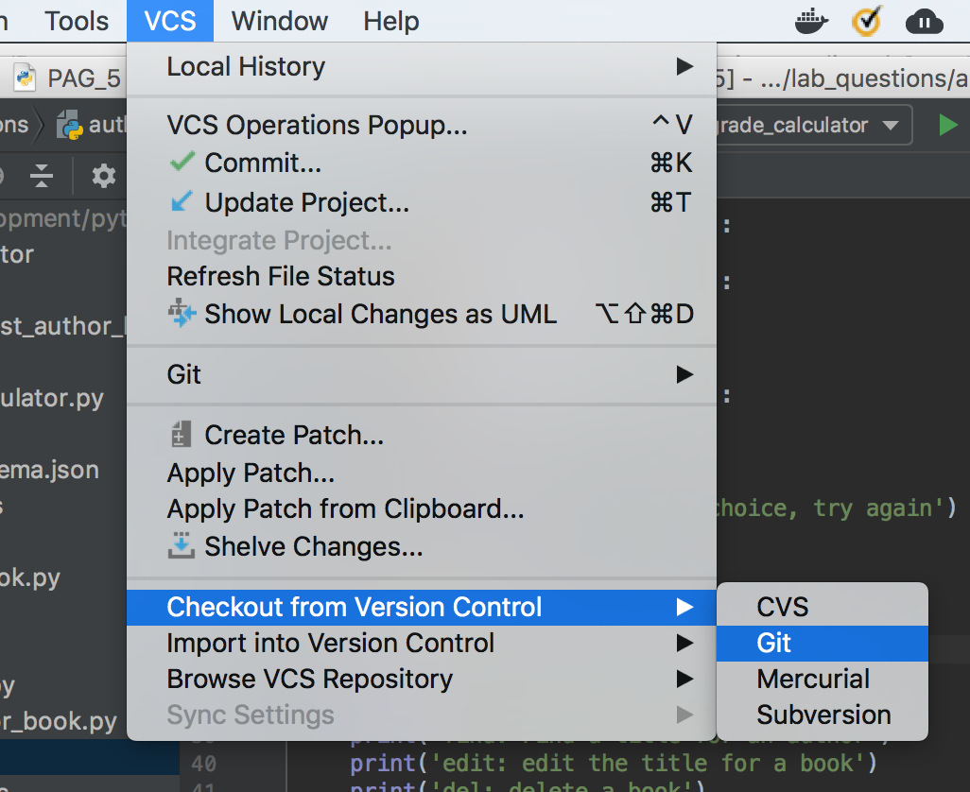
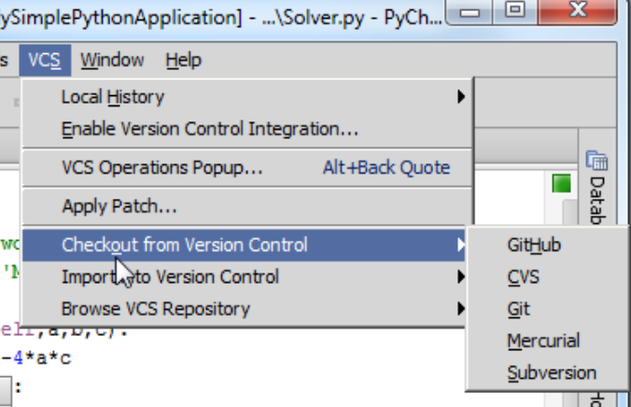
Getting the code onto your computer
PyCharm 2018: in the VCS menu, select Checkout from Version Control, and then Git
PyCharm 2016/2017: in the VCS menu, select Checkout from Version Control, and then GitHub

Slide 19
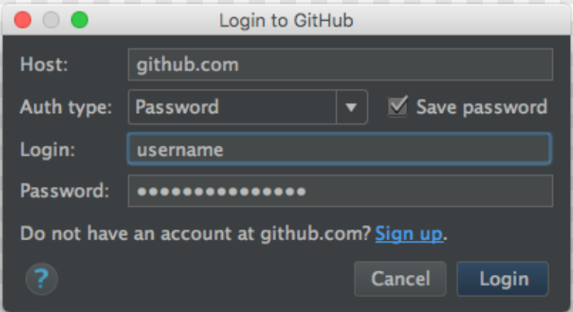
Sign in to GitHub
Make sure the Auth type: is Password
Enter your GitHub login name and password
Click Login

Slide 20
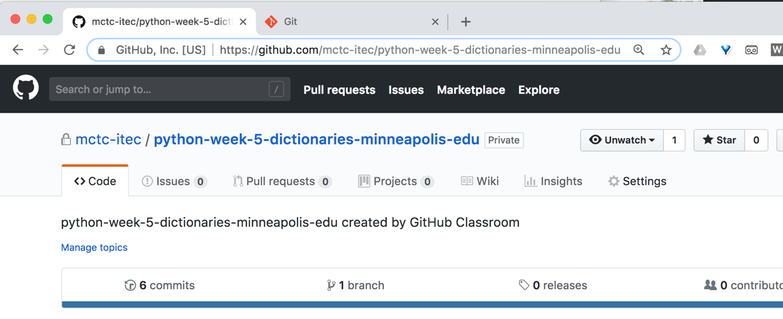
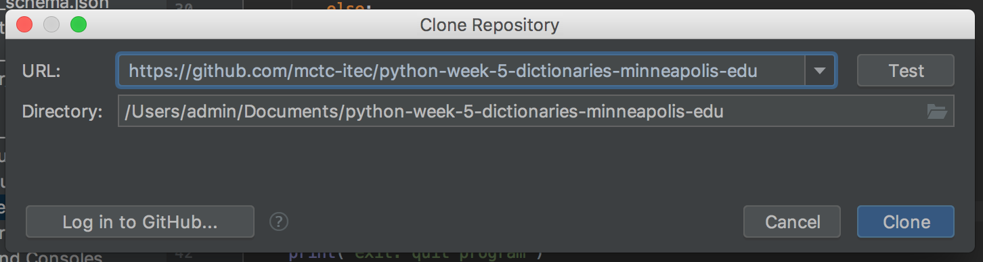
Clone (download) your repository
This is the URL to copy
Paste the URL from your repository into the URL field
Change the directory location if you like, or keep the suggested location
Your code will be downloaded here
Click the Clone button

Slide 21
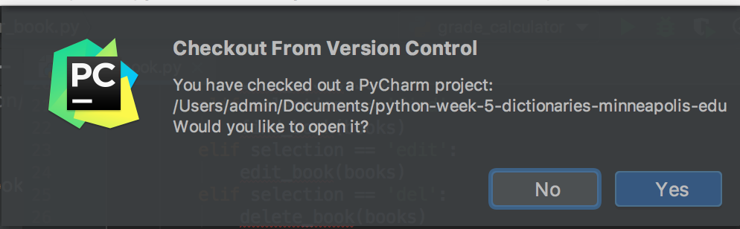
Would you like to open the project?
Click Yes

Slide 22
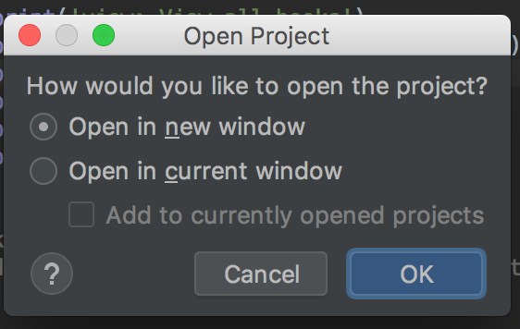
How would you like to open the project?
If you already have a PyCharm project open, you'll see this window
Pick either option

Slide 23
No Python interpreter configured for this project?
Click on the Configure Python Interpreter link and choose the latest Python 3 interpreter you have installed
On the lab computers, click on the Project Interpreter dropdown, select 3.6.0 (C:\Program Files\Python36\python.exe)
Shout out if you need help!

Slide 24
Package requirement 'unittest-xml-reporting==2.2.0' not satisfied
Click the install requirement link
If it errors, or if the warning keeps popping up, it doesn't matter for this lab. Click on Ignore Requirement
What is this? It's a library for generating reports from code tests, it's used by the autograder for this lab. If it errored and you want to fix the error, open the terminal by clicking on the dark gray square, lower left corner of PyCharm, and type the following:
pip install --user -r requirements.txt
Then close the terminal.

Slide 25
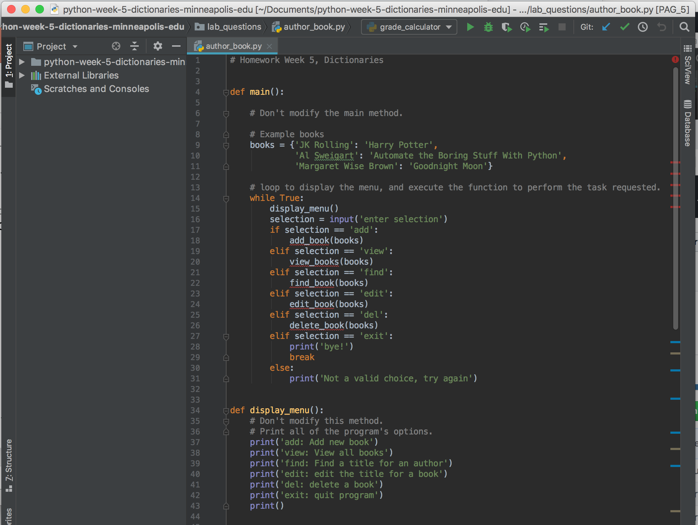
Project code
Some code is already written for you.
Your task for this lab is to finish it

Slide 26
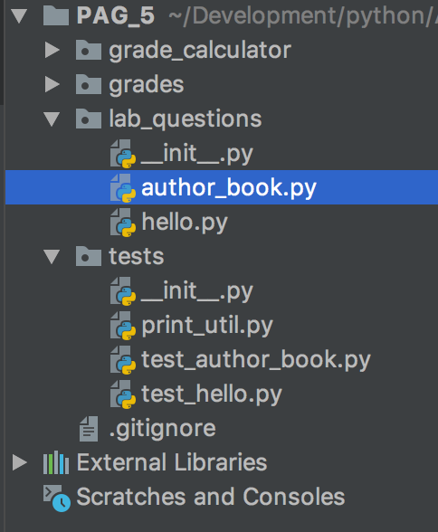
Project code
One file you will be working with is called author_book.py and it is in the lab_questions directory
Find this file and open it, if it's not already open
Click on the triangles by a directory name to expand them and see the files

Slide 27
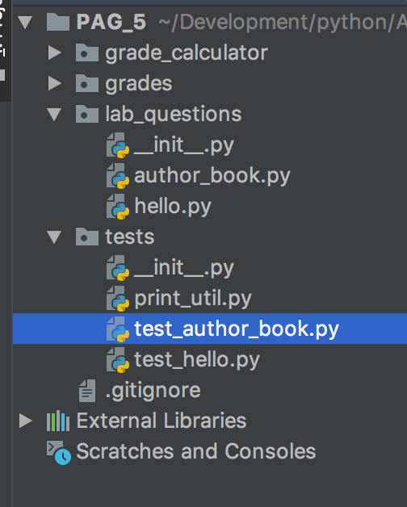
Where are the tests?
They are in a file called test_author_book.py in the tests directory
You don't need to modify this file,
although you can read it
and you'll run it, to check your code
You can ignore most of the other files in the project

Slide 28
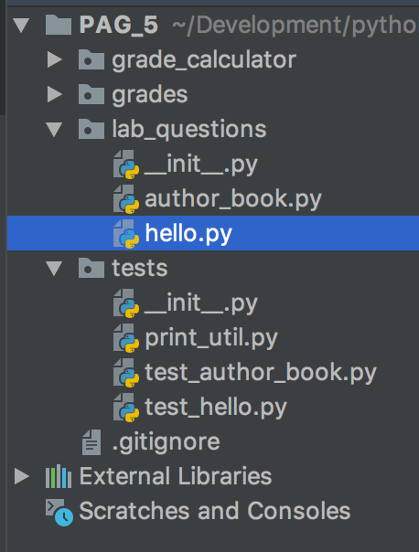
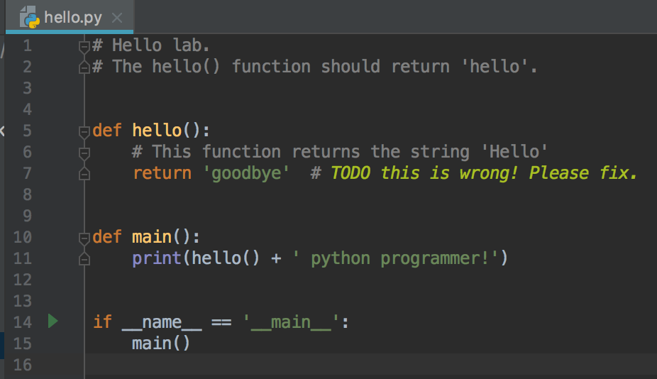
But first: we'll start with a Hello World example
Open the other python file in lab_questions called hello.py

Slide 29
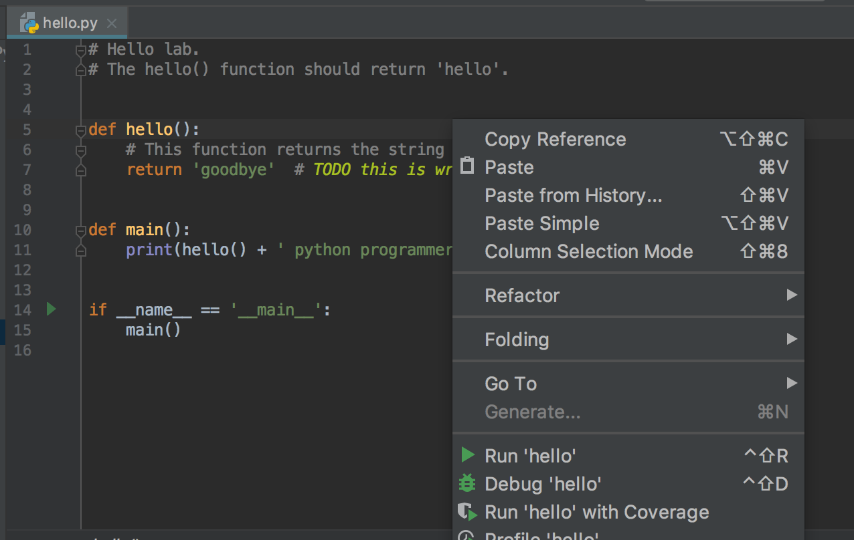
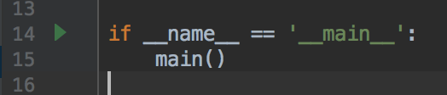
Run hello.py
Run hello.py - same was as you've done before with other programs
Right click on in the editor for this file and select Run
Or right-click on the filename in the project explorer and select Run
Or click the green arrow next to the call to main

Slide 30
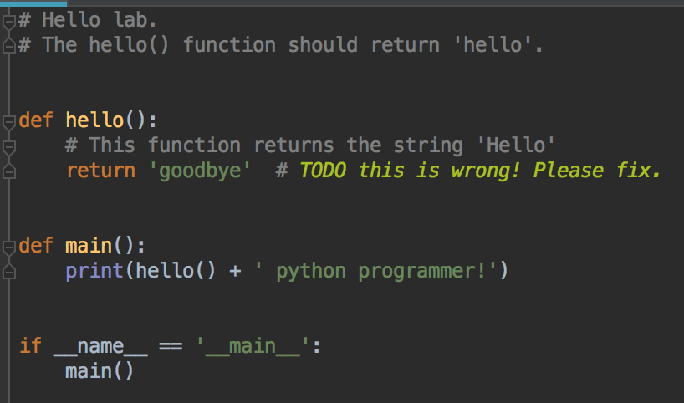
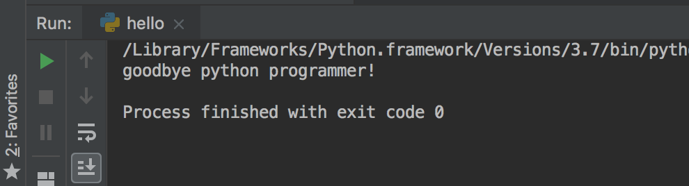
Program is not working correctly
This program should print 'hello python programmer!'
What's wrong?
Can you see the problem?

Slide 31
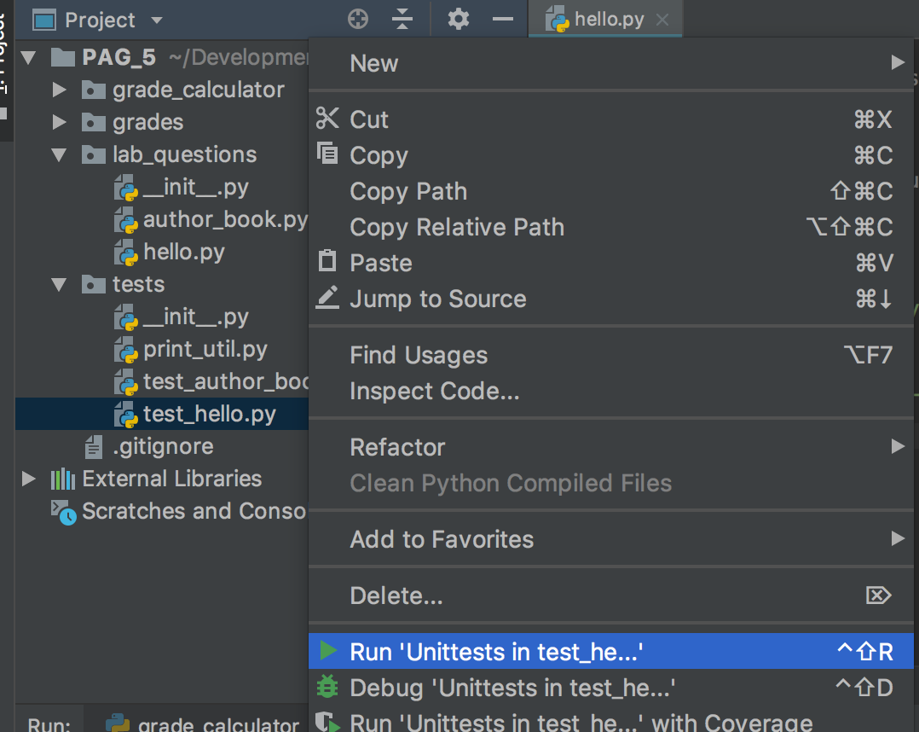
Before you fix it, let's run the test for this file
Expand the tests directory
Right-click on test_hello.py
Select Run Unittests in test_hello.py

Slide 32
Running from the terminal
To run your test, open the terminal and type
python -m unittest tests/test_hello.py

Slide 33
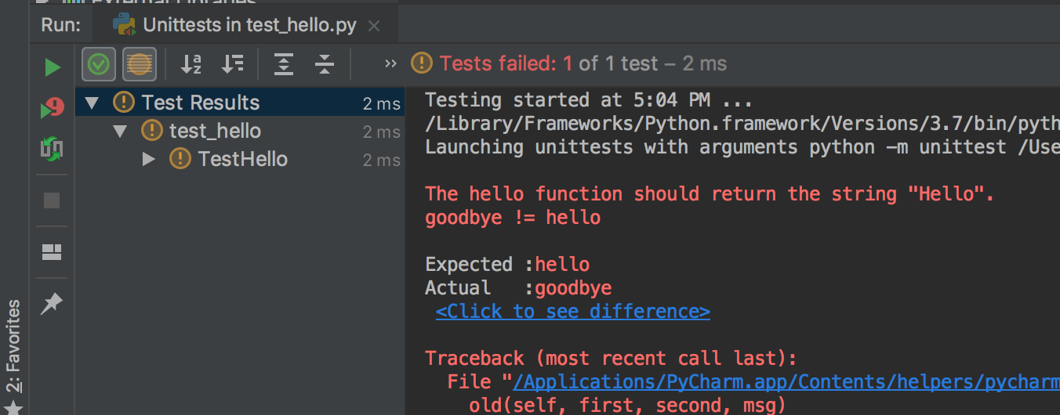
The tests check that the hello() function is working
We know it isn't working, so we expect the tests to fail
And they do - note the error message, the expected and actual output

Slide 34
Tests
There's only one test in tests/test_hello.py
Other assignment will have more tests to check more complicated functions, and features
You don't need to modify any of the test files - don't modify anything in the tests directory
So don't edit test_hello.py or test_author_book.py
You only write code in the files in the lab_questions directory

Slide 35
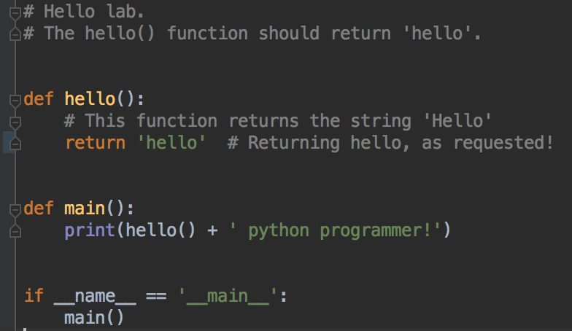
Fix the code - open hello.py
In hello.py, fix the hello() function

Slide 36
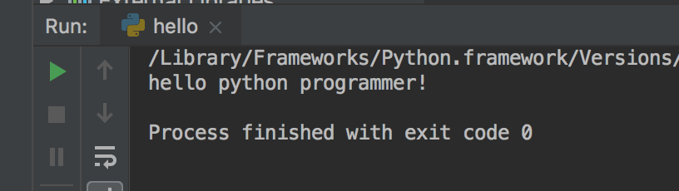
Run hello.py - does it work?
Check your code by running it as usual
That looks better!

Slide 37
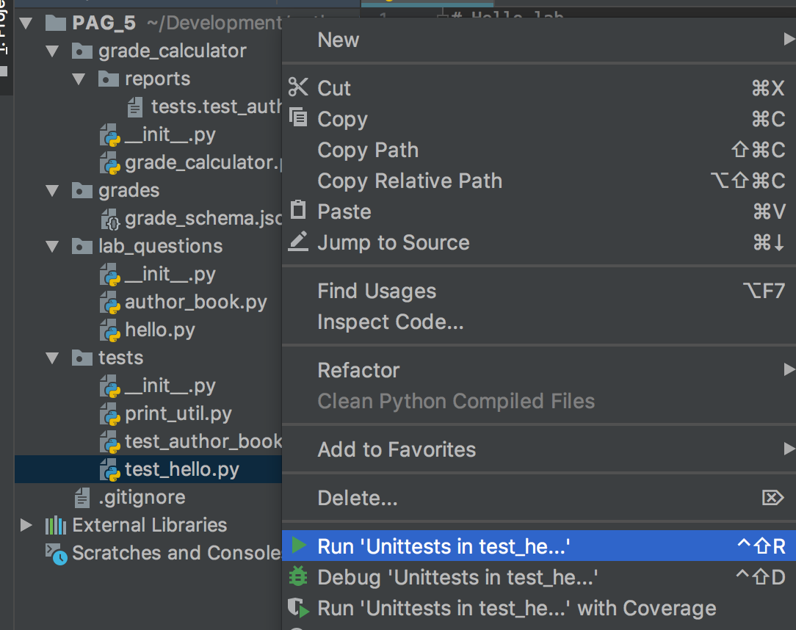
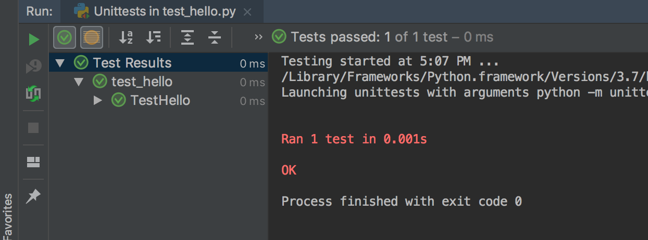
Run the tests to verify
As before - right-click on test_hello.py, select Run Unittests in test_hello.py
Now the test should pass!
Note the green checkmark icons by the test name to indicate the test passes

Slide 38
Questions?
Is your code working?
Does the test pass?
Please shout out if not!
Stuck? Something looks weird? Need help? Test still fails? We'll help!

Slide 39
Saving code to GitHub
PyCharm can upload your code to GitHub
And then the instructor will be able to review and check your work

Slide 40
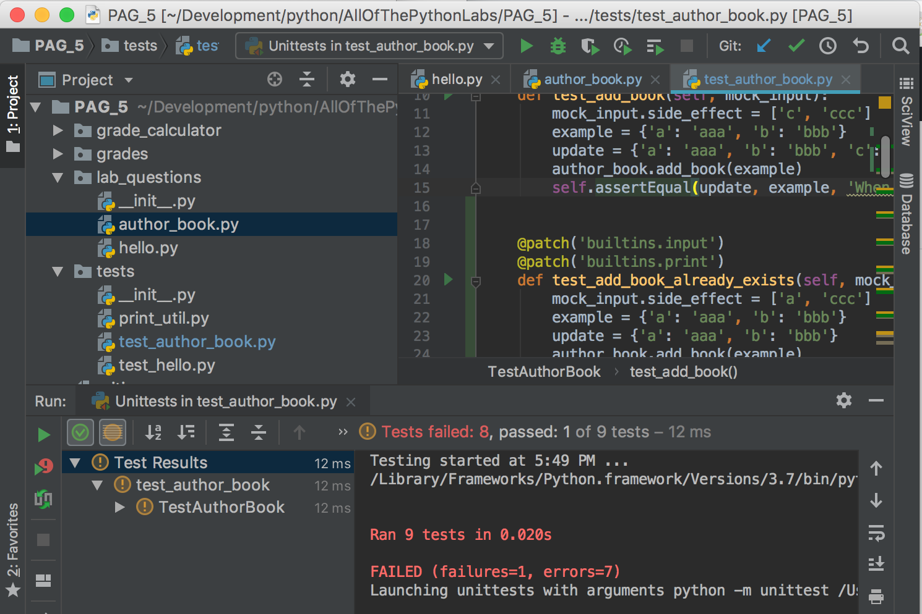
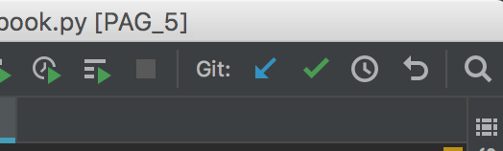
Saving code to GitHub
Look at the PyCharm icon bar for the Commit icon - a green checkmark, top right of window

Slide 41

Commit
'Commit' means to save a snapshot of your code
Useful if you are working on code, and you want to save it's current state
For example, you just got a feature working
Or you just finished an assignment question
Or you have some code working, and you are not sure how to complete the rest of the code. You'd like to save a snapshot so you can try things out, but be able to go back to the working state if things don't go well
Commit is a git operation. You'll use git a lot in 2nd year programming classes

Slide 42
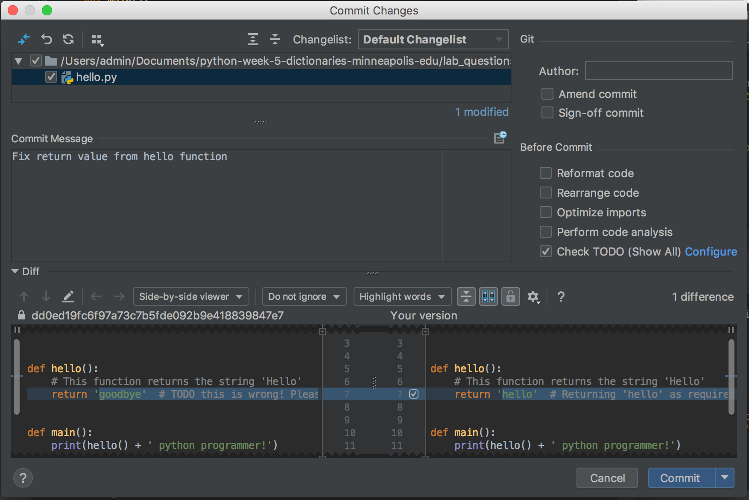
Commit
Click on the Commit icon (the green check)
Commit Changes window opens

Slide 43
Commit Changes
List of project files that you have changed
A commit message, that you will write, describing the changes
The differences between these files
Can you see where 'goodbye' was changed to 'hello' ?

Slide 44
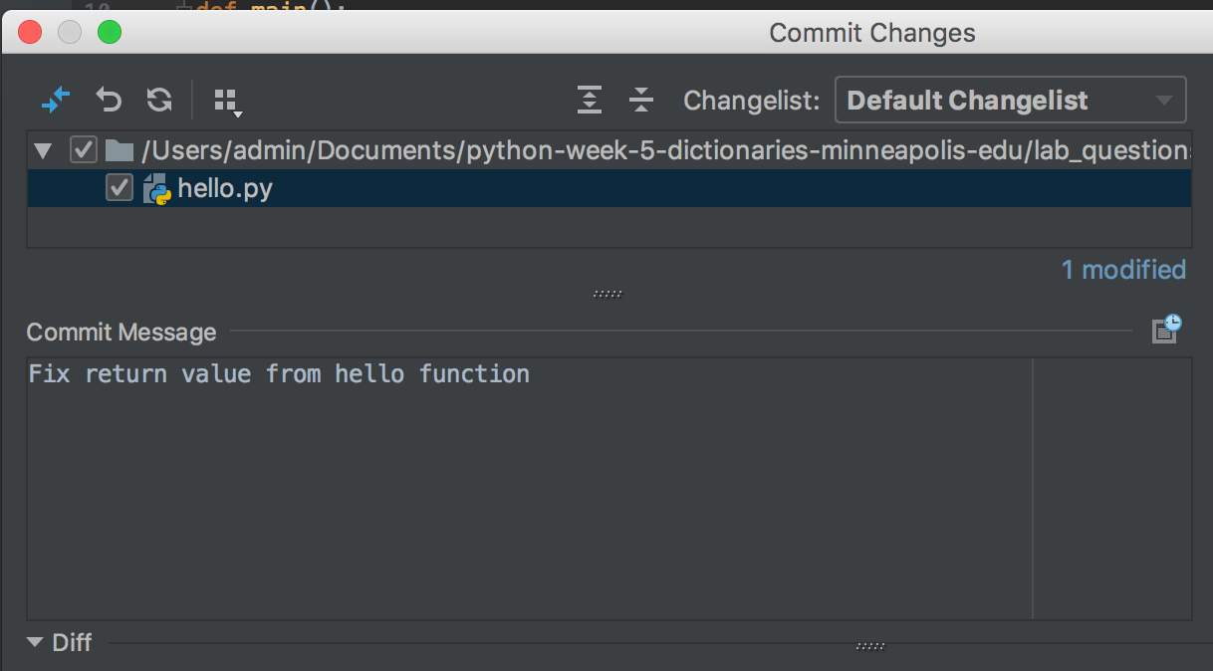
Commit Message
Delete any text in the Commit Message box, and write a short new message describing what you have changed
For example,
"Fix return value from hello function"

Slide 45
Commit Messages
Write descriptive commit messages
As a professional developer, commit messages are used by your boss/team leader to track what you've worked on
They are a very important part of a project's documentation
More on this in 2nd year programming classes

Slide 46
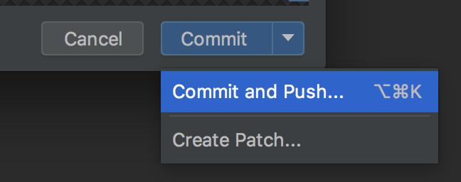
Commit and Push
Commit = save a snapshot
Push = upload changed project code to GitHub
Click on the little down arrow, on the right of the Commit button
A dropdown menu will open
Select Commit and Push

Slide 47
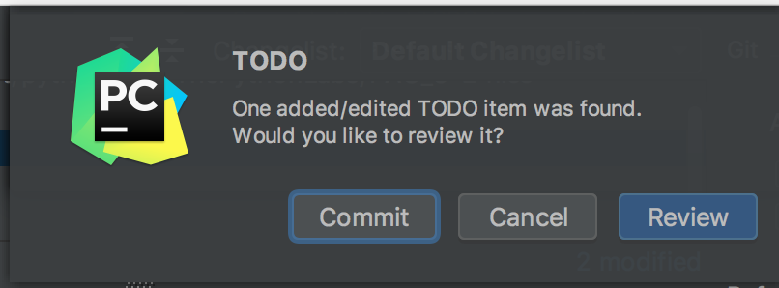
TODO
If you see a popup about added/edited TODO items, click Commit to continue

Slide 48
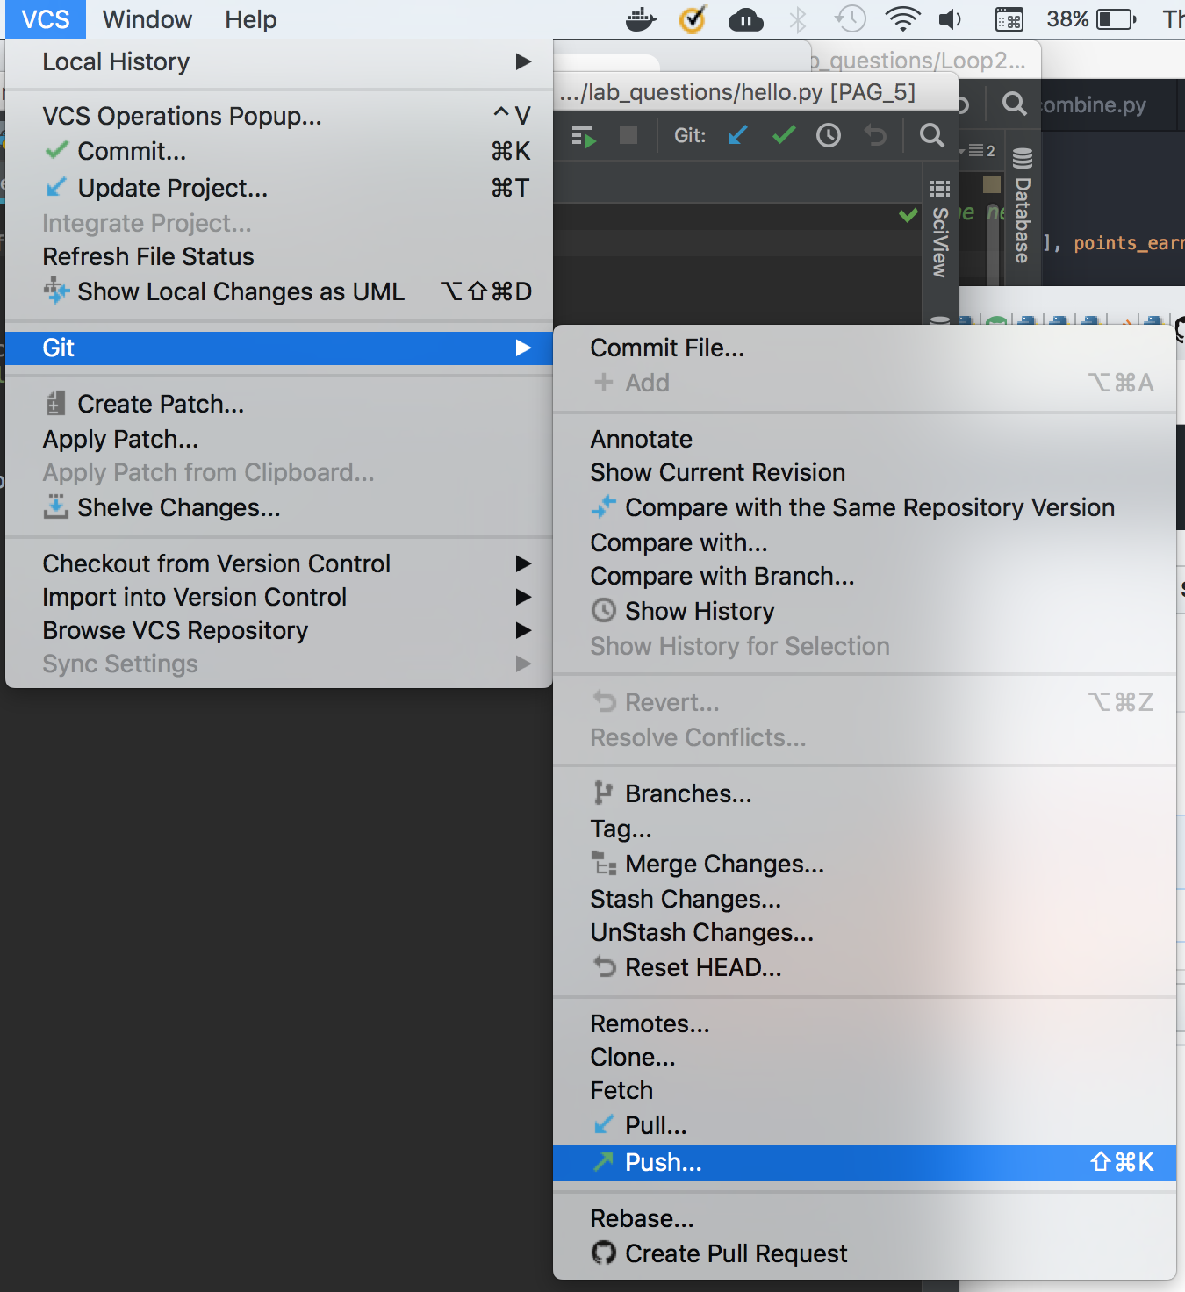
Clicked the Commit button instead of Commit and Push?
No problem!
Open the VCS menu, go down to Git, then select Push

Slide 49
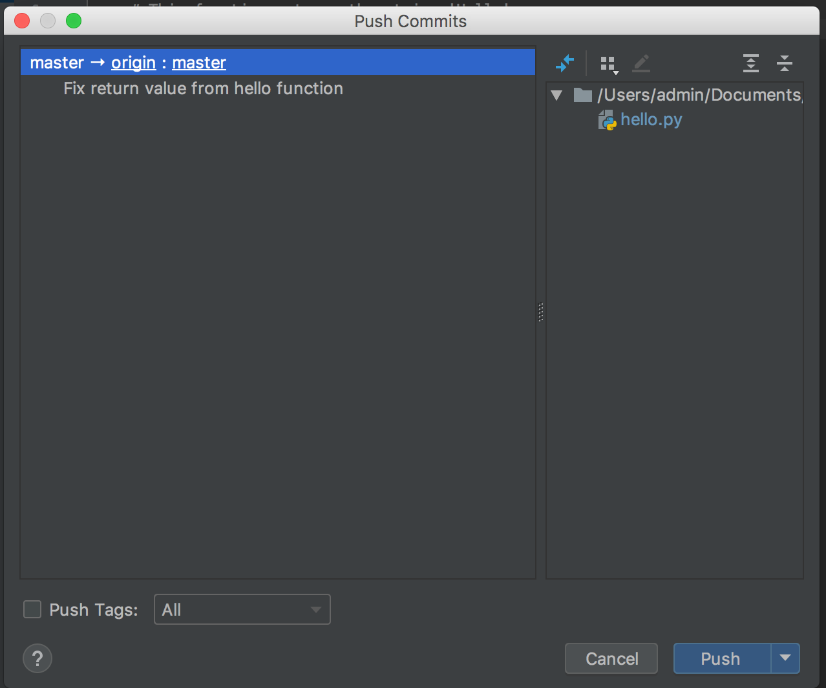
Push changes
Shows a list of your commits to be pushed (uploaded) to GitHub
Don't modify anything in this window
Click the Push button

Slide 50
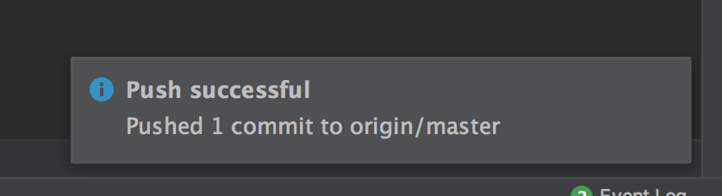
Code uploads
Success bubble!

Slide 51
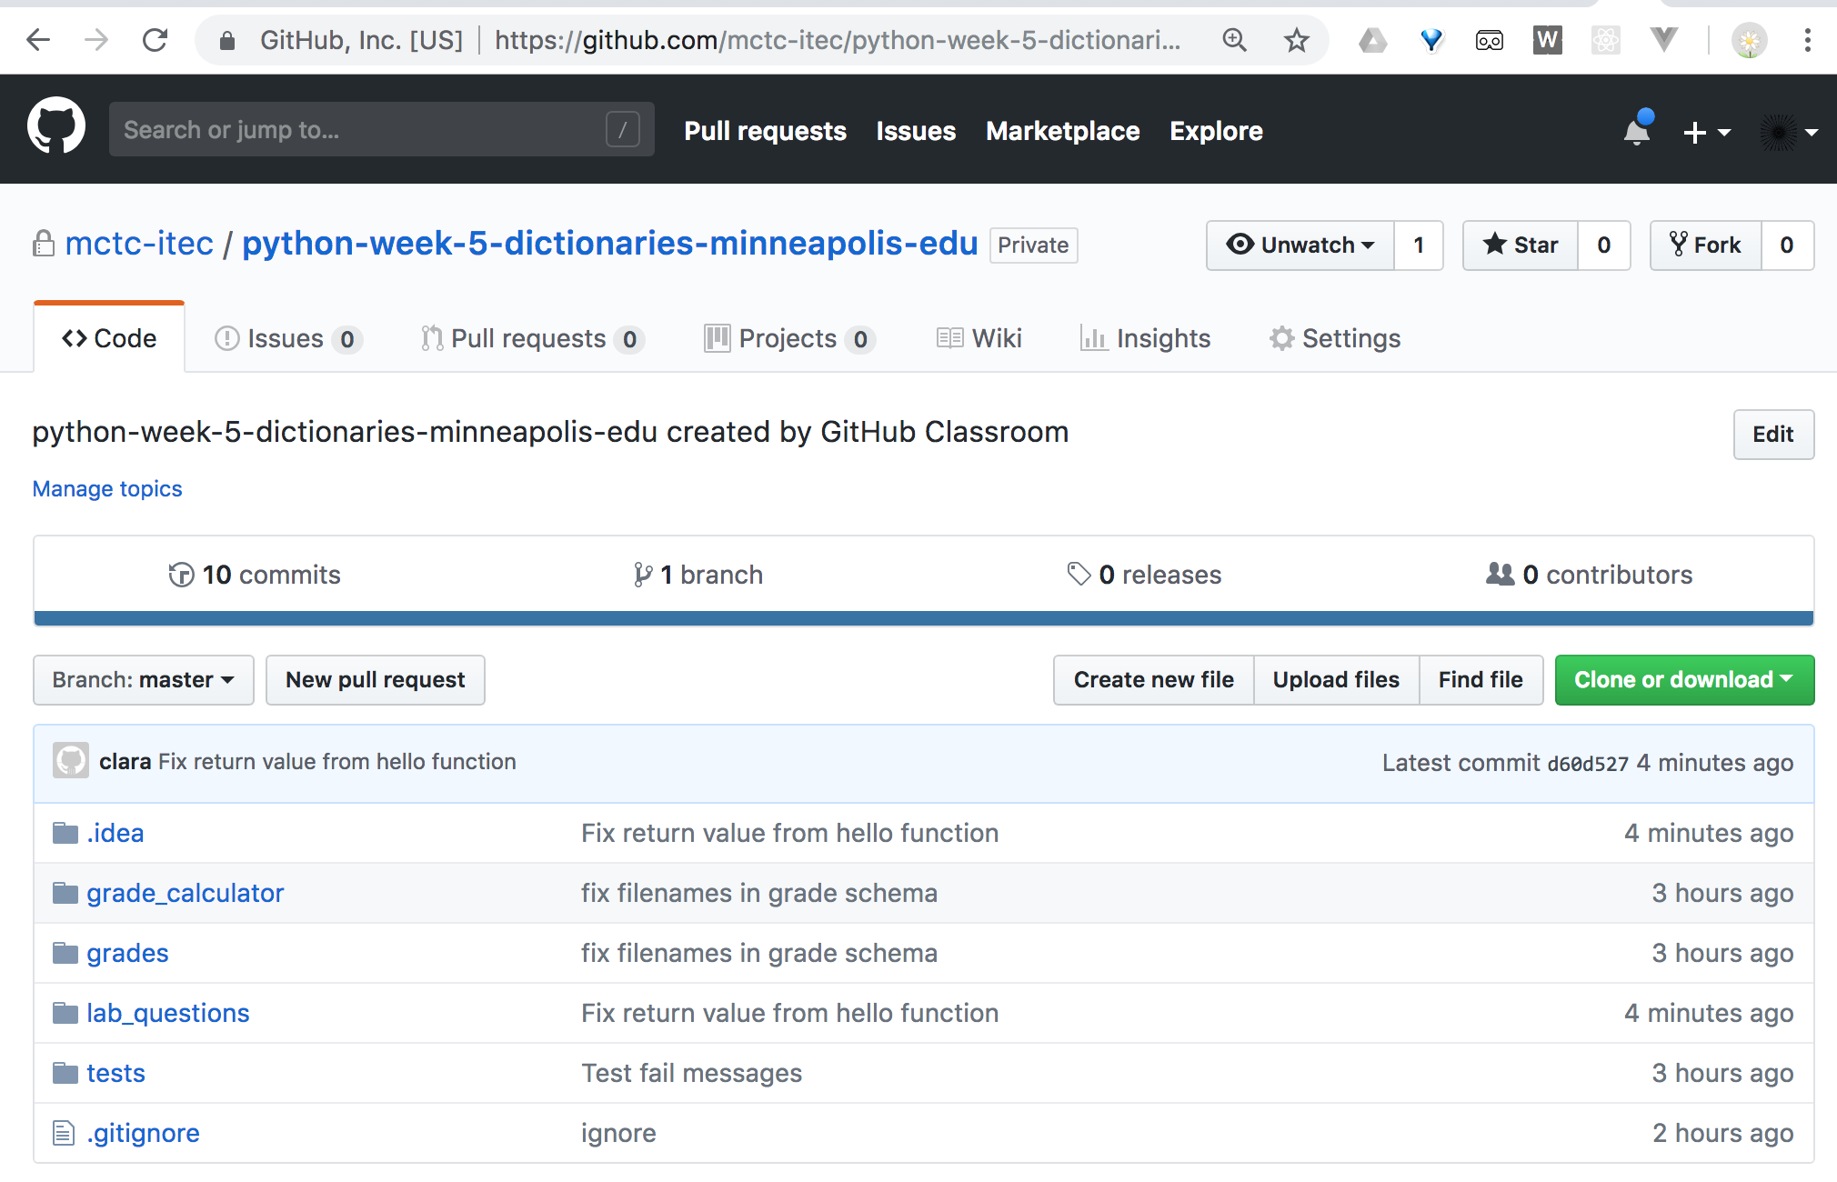
Check at GitHub
Go to the repository URL you created earlier
Look, there's your commit message

Slide 52
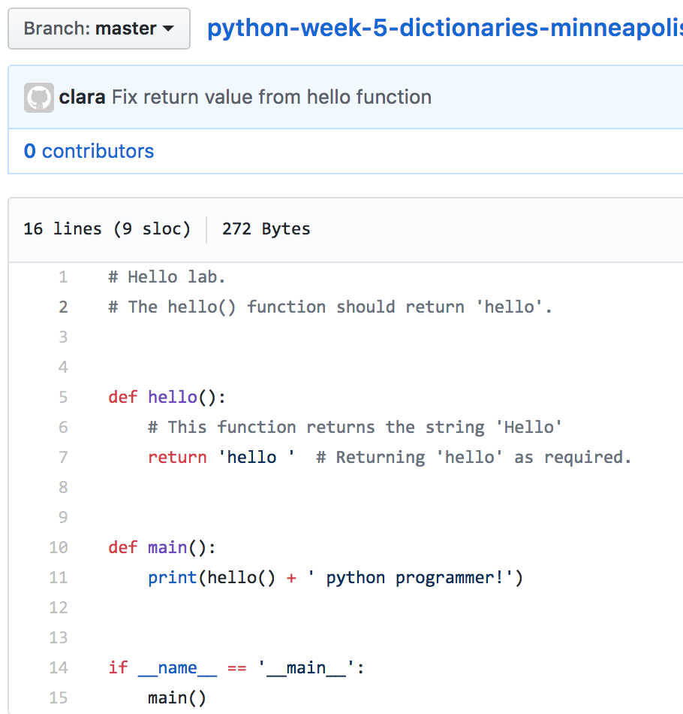
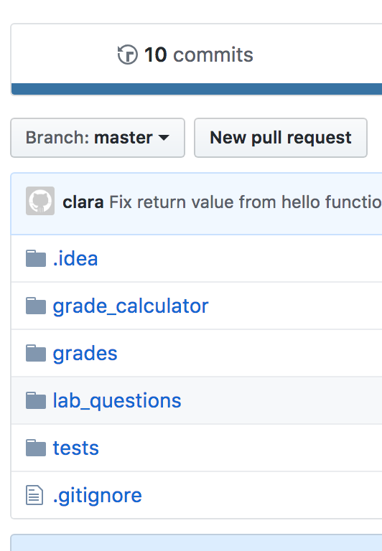
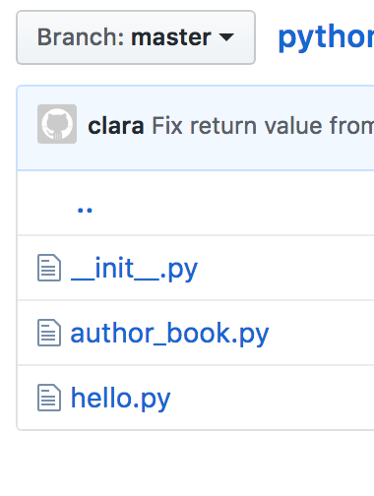
Check code at GitHub
Click on lab_questions, and then hello.py
Verify your changes were uploaded

Slide 53
The instructor has access to your repository
You and the instructor can both see the code in your repository
Otherwise, it's private, no-one else can see it
But, by default, other GitHub repositories are public
Useful for sharing, or creating a portfolio of your coding work

Slide 54

Questions?
We've introduced many new systems and tools today
So it might feel a bit overwhelming now...
Please ask if anything isn't working!
Don't worry - focus on getting things working today, and you'll have plenty of opportunities to practice in the future
You'll learn more about these technologies in future programming classes
Please ask after class if you want to learn more now!

Slide 55
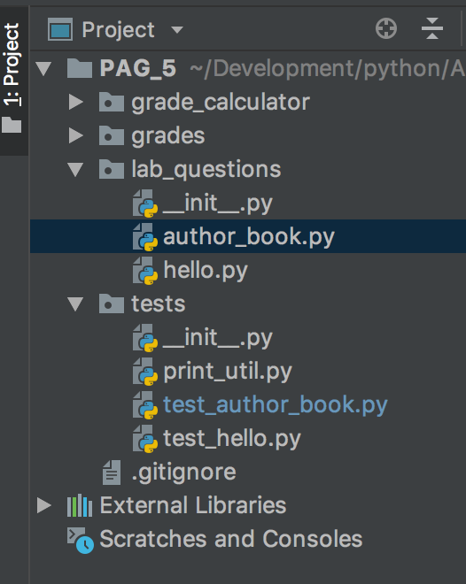
Author and Book Program
Dictionaries!
Similar structure to the hello.py program,
the lab_questions/author_book.py program has code,
and tests/test_author_book.py has the tests
You'll finish the code in lab_questions/author_book.py
Remember - don't modify the test code in tests/test_author_book.py

Slide 56
Running the lab code
Just like the hello.py program, the author_book.py program has code, and also tests in tests/test_author_book.py
You'll finish the code in lab_questions/author_book.py
Check your work by
1. ALWAYS running your code and checking manually,
2. AND running the tests in tests/test_author_book.py
It's import to do both! Why?
Hint: can the tests check for every aspect of your code working?
Do you have time to check for every detail every time you change anything?

Slide 57
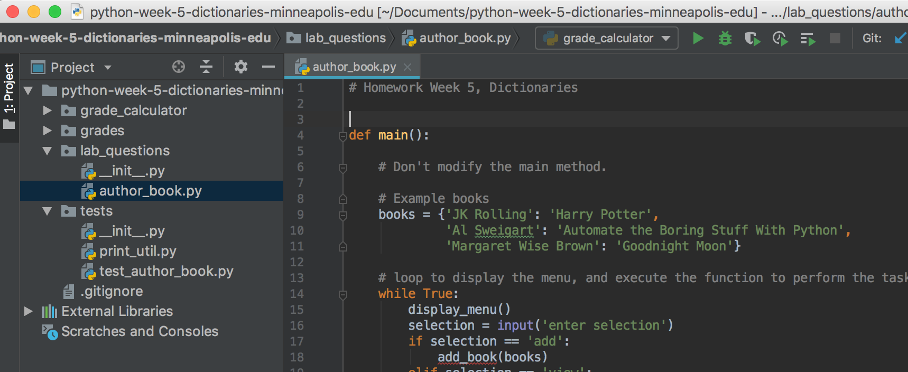
Run the lab code
Open the lab_questions/author_book.py file

Slide 58
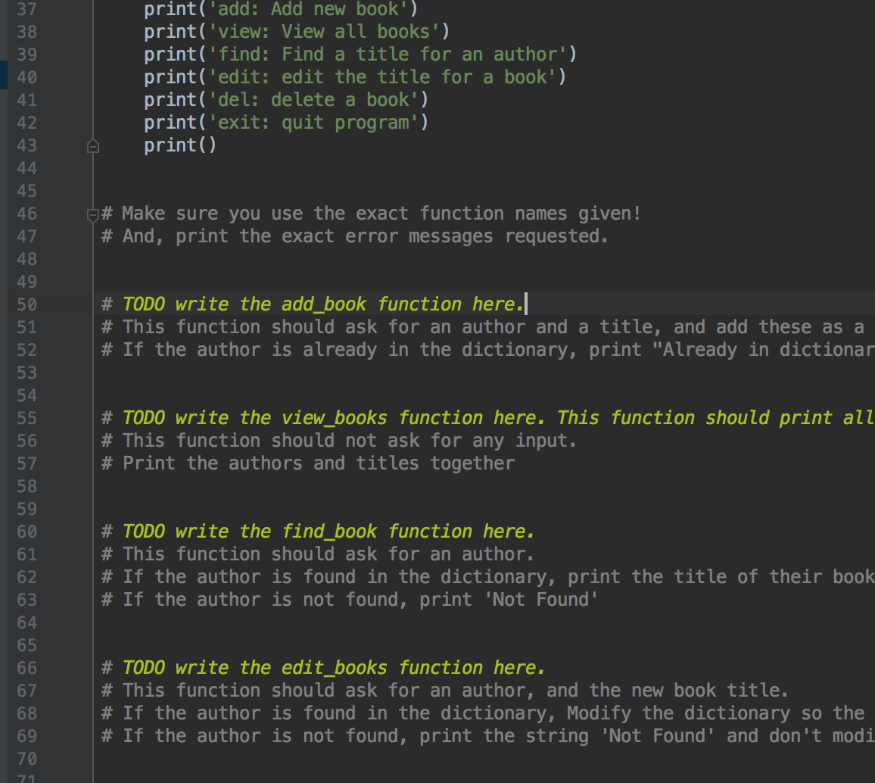
Instructions
For this lab, the instructions are in the lab_questions/author_book.py file
Scroll down, and look for the yellow
# TODO comments and notes
# TODO comments will be highlighted in blue, if you are using the light color scheme
TODO comments don't mean anything for your python program, but are useful for programmers

Slide 59
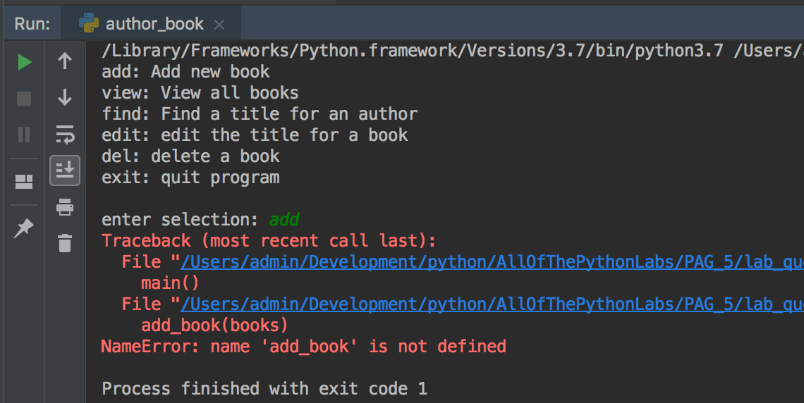
lab_questions/author_book.py
Try running the code
It will crash once you enter a menu selection
Why? The functions it expects to call have not been written yet
That's your task for this lab!

Slide 60
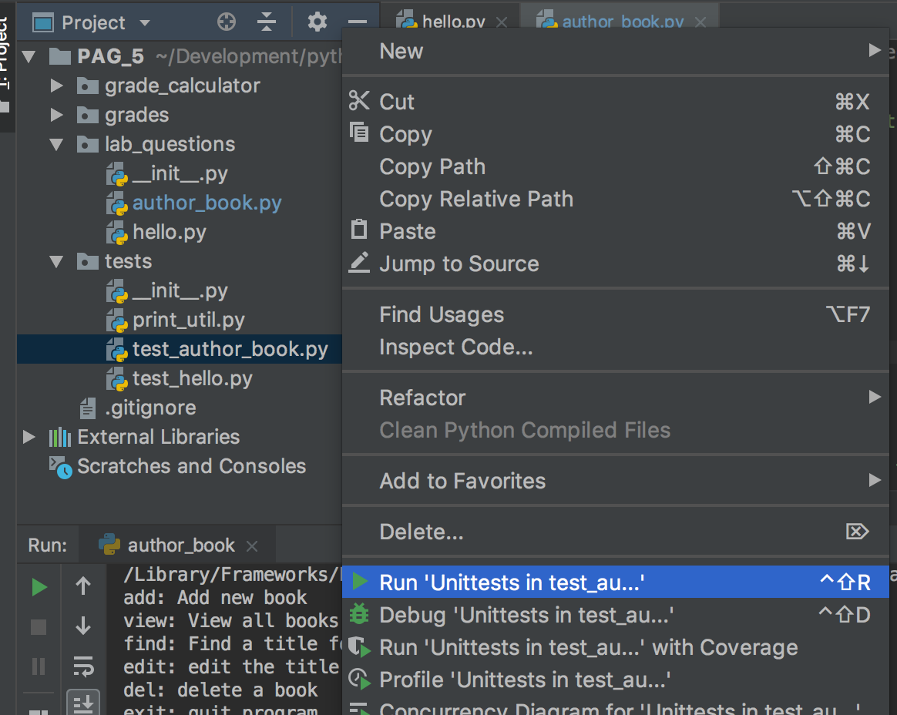
tests/test_author_book.py
Let's run the tests
Open the tests directory, and right-click on test_author_book.py
Select Run Unittests in test_author_book.py
There are nine tests for this program

Slide 61
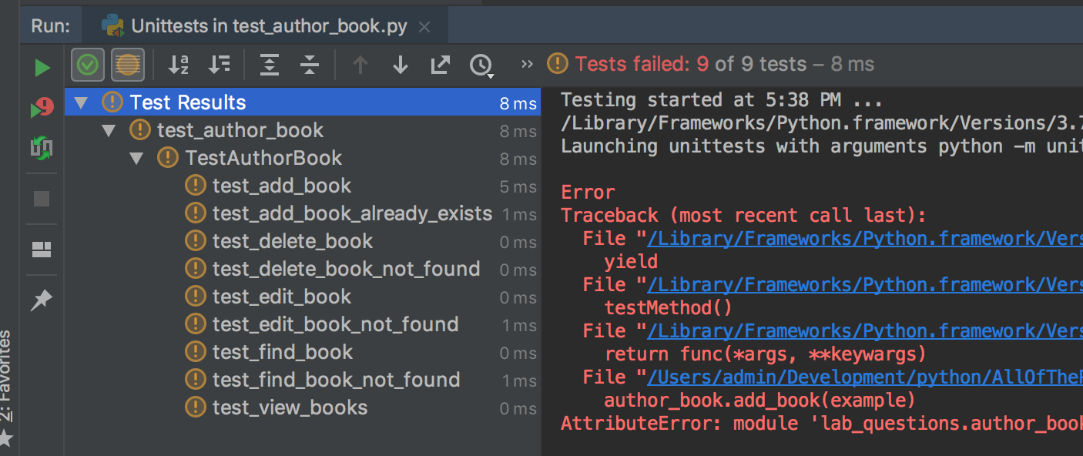
Test failures
As expected, all 9 tests fail

Slide 62
Run tests from Terminal
python -m unittest tests/test_author_book.py

Slide 63
Work on code
Let's write the add_book function
According to the assignment:
"This function should ask for an author, and a title, and add these as a new key:value pair to the books dictionary. If the author is already in the dictionary, print "Already in dictionary" and don't modify the dictionary. Your program should not crash"

Slide 64
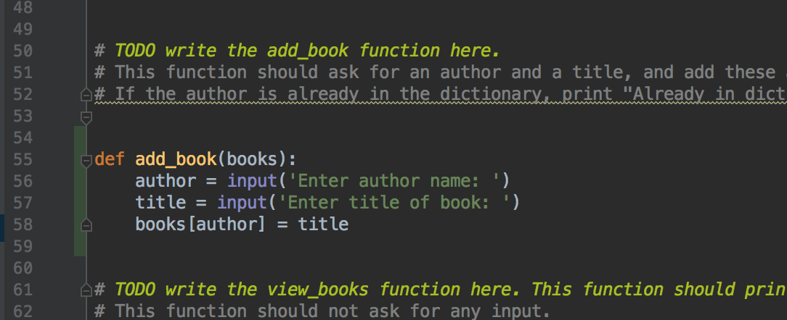
First attempt
Write the add_book function in author_book.py

Slide 65

Run tests in test_author_book.py
The first test is passing!
You may need to click on the triangle arrow by TestAuthorBook to see all the tests
Click on the triangle to expand the list of tests
First passing test for this question!

Slide 66

Run tests in test_author_book.py
Click on the first failing test, test_add_book_already_exists
Look at the errors message on the right
What's wrong with the code?

Slide 67
Review the instructions
"... If the author is already in the dictionary, print "Already in dictionary" and don't modify the dictionary. Your program should not crash"

Slide 68

Modify author_book.py add_book() function
Check to see if the author is already in the books dictionary before adding, and print message for the user

Slide 69

Run the tests again
Two tests passing!
test_add_book_already_exists is passing
If not, make sure you print the exact message "Already in dictionary" because the test is looking for that exact output
Check the logic of your if statement
Ask for help if it's still not working

Slide 70

Help!
If either/both of your test_add_book and tests_add_book_already_exists tests are failing:
Click on the failing test and look at the error message in the right panel - that should give you a clue
Make sure you print the exact message "Already in dictionary" because the test is looking for that exact output
Check the logic of your if statement
Ask for help if it's still not working
Right logic, wrong message when author is already in the dictionary
Error message indicates the problem

Slide 71
Your turn!
Finish the rest of the code
Read the instructions in author_book.py and write the rest of the functions:
view_books
find_book
edit_book
delete_book
Make sure your function names match the names used
Read the instructions carefully so you know what is required

Slide 72
Your turn
As you work on the lab, run your program and check that it's working
Check it manually - run the code and verify it's working
And run the tests and make sure the functions are working
Remember: it's important to do both to check your code!

Slide 73
Finishing up - push to GitHub
When you are finished, or it's the end of the lab, push your code to GitHub
Click the commit icon
Write a descriptive commit message - what did you get done?
For example: "Finished author_book program"
or "completed add and edit functions"
Hover over the Commit button and click on Commit and Push
In the Push window, Click Push

Slide 74
Finishing up - push to GitHub
Go to your GitHub URL and verify your updates and code is there
Tell the instructor what your GitHub ID is so we can find your code
Print it clearly on the sign-in sheet

Slide 75

Optional: Estimated Grade grade_calculator.py
If unittest-xml-reporting installed correctly, open the grade_calculator directory, and find the grade_calculator.py file
Run this file

Slide 76

Optional Estimated Grade grade_calculator.py
Look at the report generated
It estimates your grade for this lab, based on the number of tests that passed

Slide 77

Well done!
That's a lot of new things!
As a professional developer, you'll use GitHub, git, and testing at work
You'll get a lot more practice in future programming classes
So don't worry if you don't understand it all now - we covered a lot at a high level
Questions? Want more detail? Please ask!
And/or you can email me at clara.james@minneapolis.edu

